Slide 1
OS

Slide 2
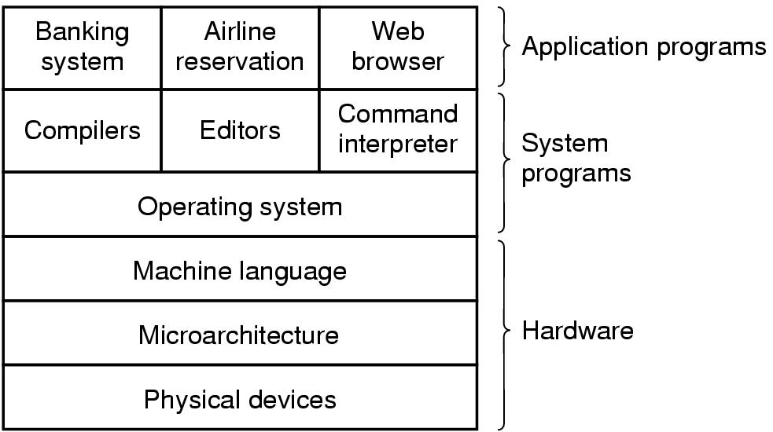
Introduction
A computer system consists of
hardware
system programs
application programs

Slide 3
What is an Operating System
It is an extended machine
Hides the messy details which must be performed
Presents user with a virtual machine, easier to use
It is a resource manager
Each program gets time with the resource
Each program gets space on the resource

Slide 4
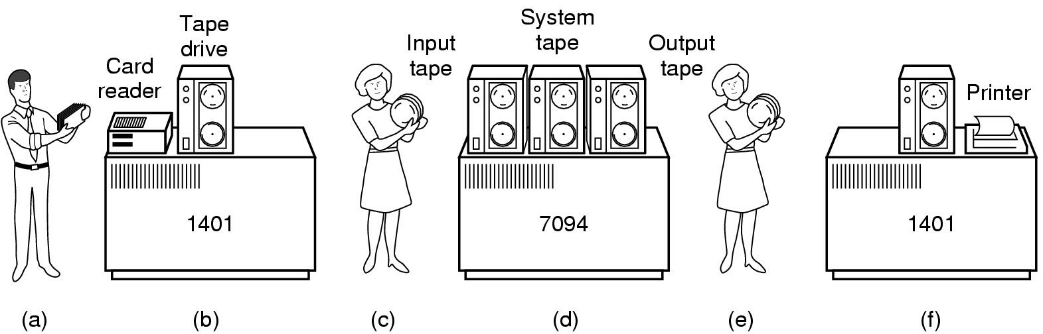
History of Operating Systems (1)
Early batch system
bring cards to 1401
read cards to tape
put tape on 7094 which does computing
put tape on 1401 which prints output

Slide 5
History of Operating Systems (2)
First generation 1945 - 1955
vacuum tubes, plug boards
Second generation 1955 - 1965
transistors, batch systems
Third generation 1965 – 1980
ICs and multiprogramming
Fourth generation 1980 – present
personal computers

Slide 6
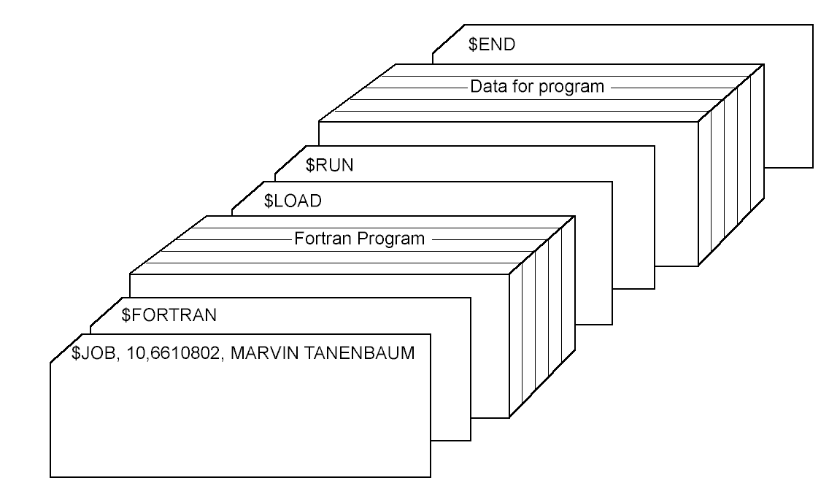
History of Operating Systems (3)
Structure of a typical FMS job – 2nd generation

Slide 7
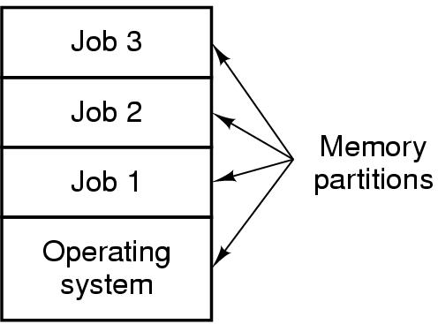
History of Operating Systems (4)
Multiprogramming system
three jobs in memory – 3rd generation

Slide 8
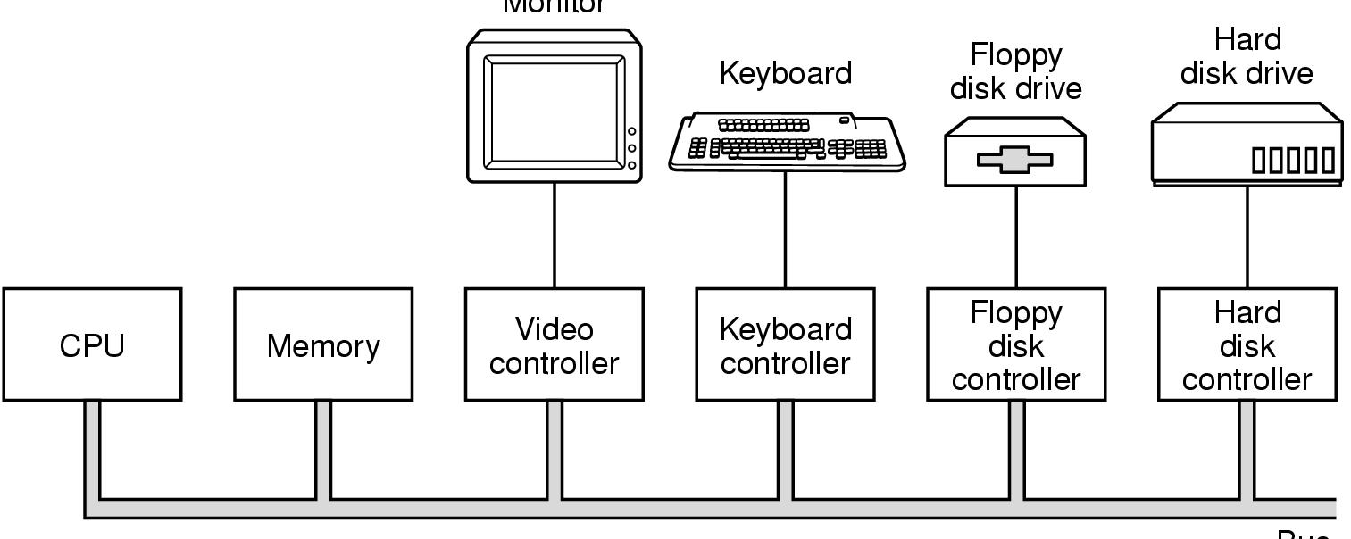
Computer Hardware Review (1)
Monitor
Bus
Components of a simple personal computer

Slide 9
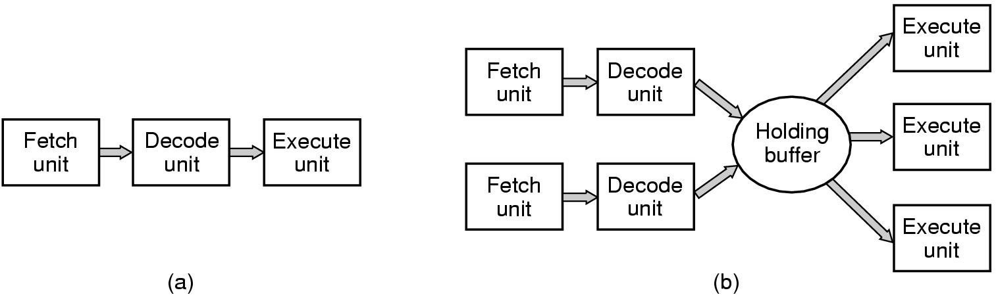
Computer Hardware Review (2)
(a) A three-stage pipeline
(b) A superscalar CPU

Slide 10
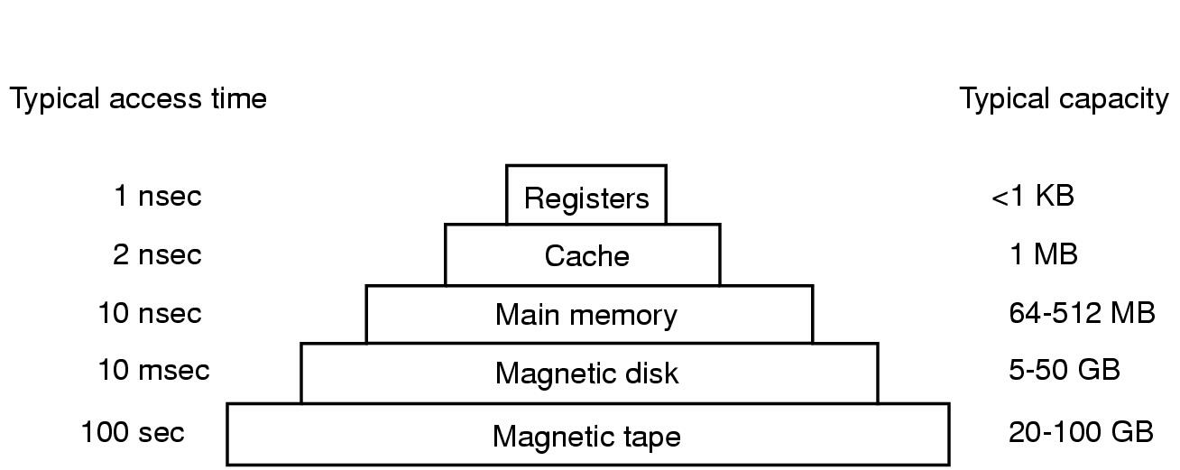
Computer Hardware Review (3)
Typical memory hierarchy
numbers shown are rough approximations

Slide 11
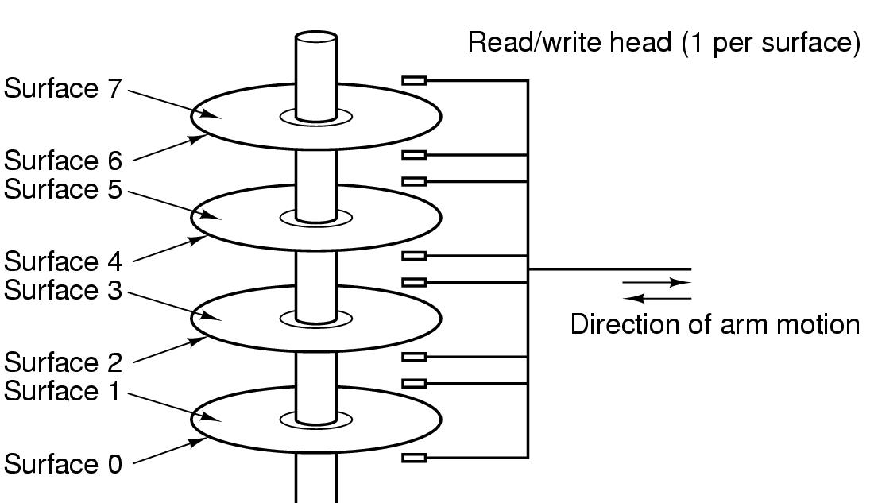
Computer Hardware Review (4)
Structure of a disk drive

Slide 12
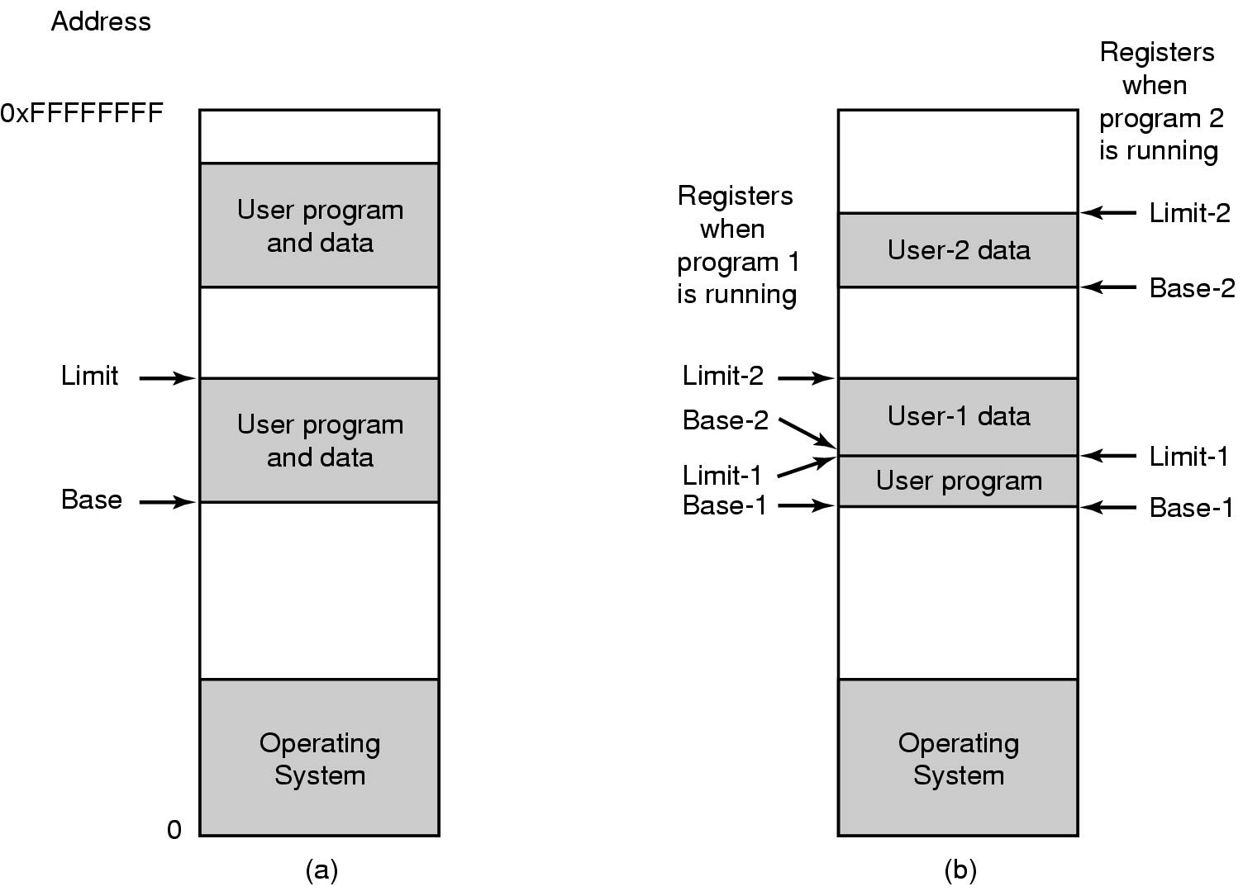
Computer Hardware Review (5)
One base-limit pair and two base-limit pairs

Slide 13
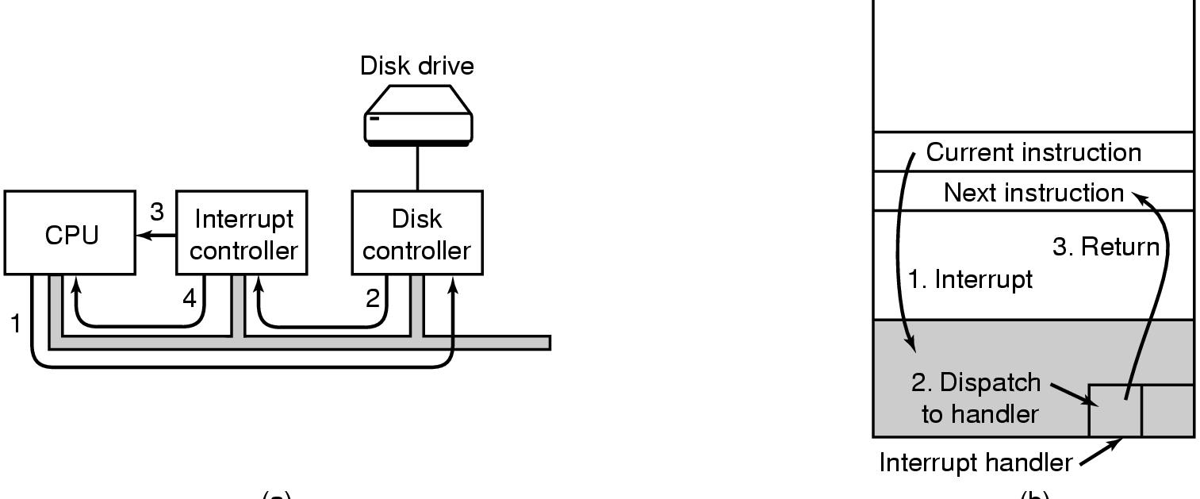
Computer Hardware Review (6)
(a)
(b)
(a) Steps in starting an I/O device and getting interrupt
(b) How the CPU is interrupted

Slide 14
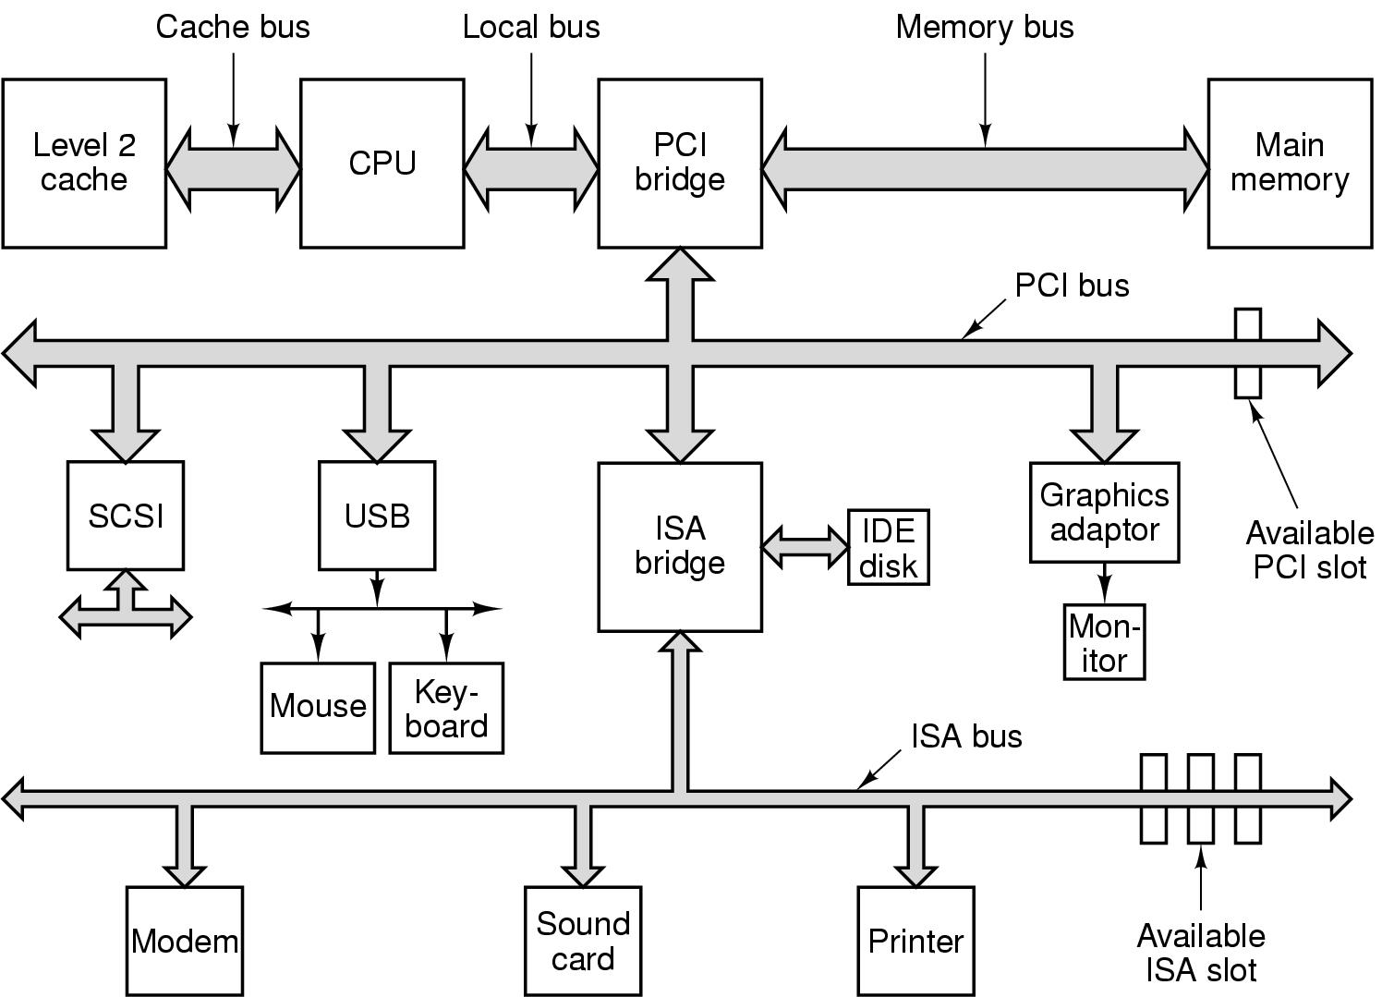
Computer Hardware Review (7)
Structure of a large Pentium system

Slide 15
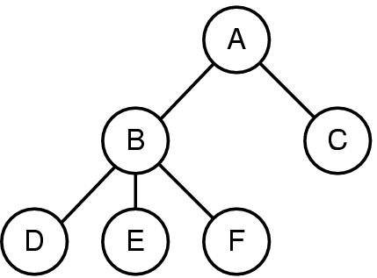
Operating System Concepts (1)
A process tree
A created two child processes, B and C
B created three child processes, D, E, and F

Slide 16
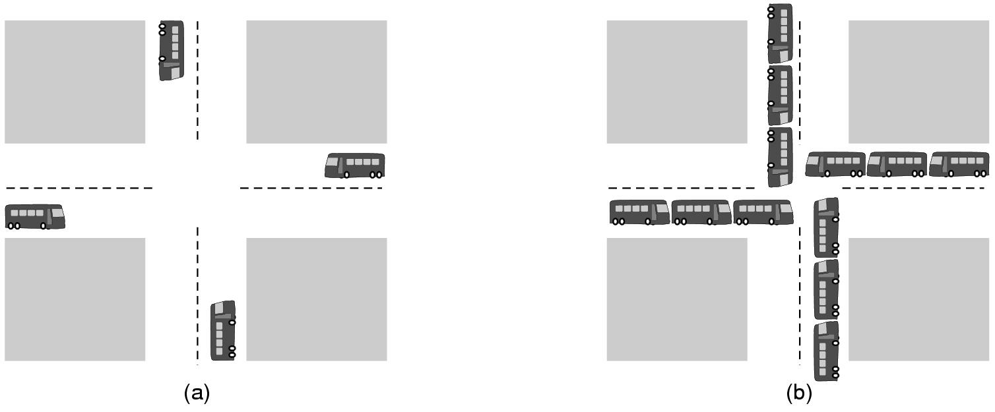
Operating System Concepts (2)
(a) A potential deadlock. (b) an actual deadlock.

Slide 17
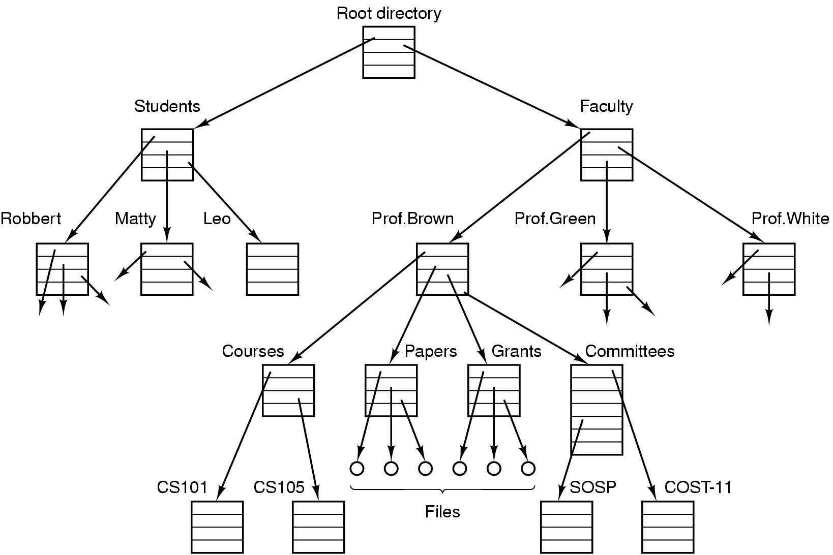
Operating System Concepts (3)
File system for a university department

Slide 18
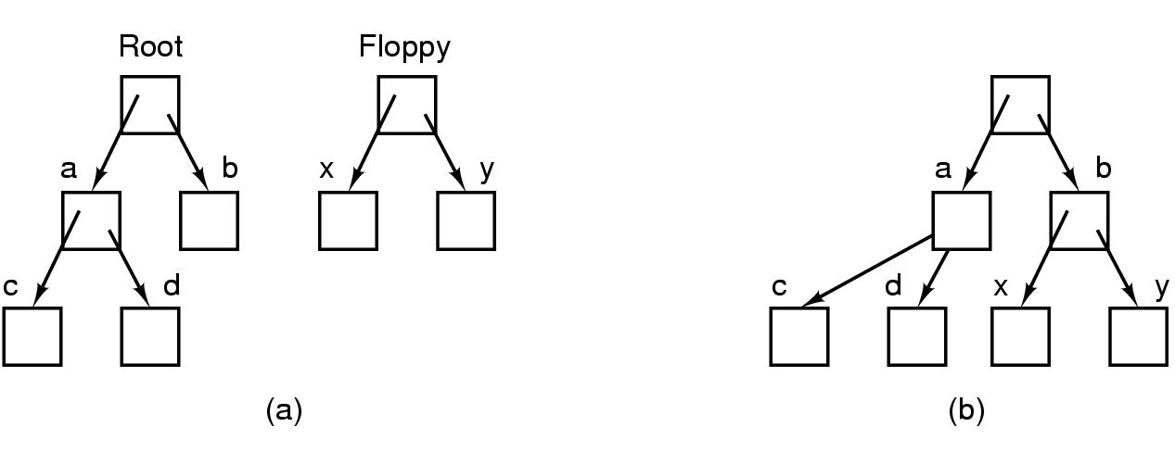
Operating System Concepts (4)
Before mounting,
files on floppy are inaccessible
After mounting floppy on b,
files on floppy are part of file hierarchy

Slide 19
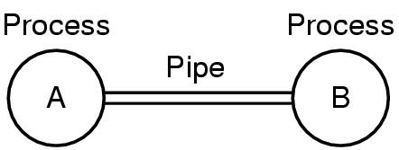
Operating System Concepts (5)
Two processes connected by a pipe

Slide 20
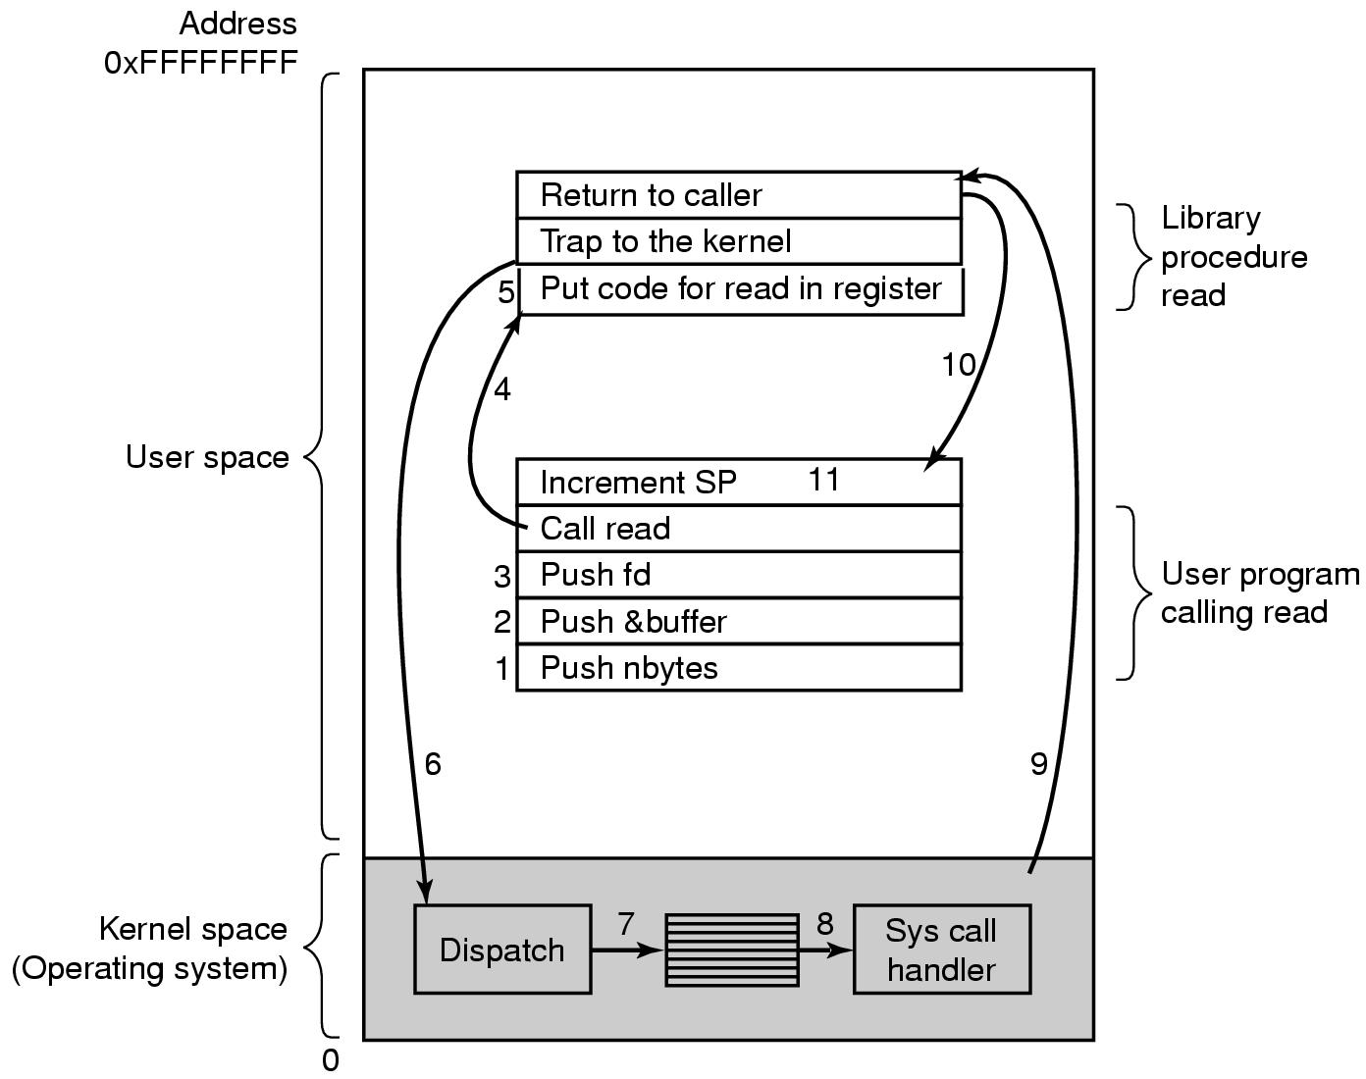
Steps in Making a System Call
There are 11 steps in making the system call
read (fd, buffer, nbytes)

